Slide 1
SDM 3.0 Basic Orientation for Experienced Trainers

Slide 2
Agenda
One-Day Experienced SDM Trainer Basic Orientation Update
Background and highlights of SDM 3.0 tool revisions
Review of revised SDM 3.0 Basic Orientation
“Mechanics” of Find the Fuel activity
Case Example review and teaching points

Slide 3
Why Update the SDM assessments?
Better Decisions and Outcomes for Children and Families
Last major workgroup development 1999;
Only minor changes and updates since
Address known issues; Response Priority for example
Practice has evolved since 1999
Stronger integration of tools in fill and balanced assessment process

Slide 4
Hotline Tool Screening Criteria

Slide 5
Structure and Physical Abuse Criteria
Key changes
Review of Criteria Not Required moved to beginning of assessment and defined
Physical Abuse:
Definitions refined to focus on caregiver action and impact on child
Includes physical harm as result of domestic violence
Caregiver action that caused or will cause injury generally replaces threats of physical abuse and excessive discipline and more clearly provides a focus on actions by the caregiver and impact on child

Slide 6
Physical Abuse Criteria
Key Changes
Emotional Abuse:
Definitions refined to focus on caregiver action and impact on child
Exposure to domestic violence has the same purpose and impact
Above combined removes the need for threat of emotional abuse

Slide 7
Commercial Sexual Exploitation or Sexually Trafficked
Tracking information for Commercially Sexually Exploited and/or Sex Trafficked
Check boxes when an in-person response has been indicated and the maltreatment criterion is either commercial sexual exploitation where the child is sexually trafficked or failure to protect from sexual trafficking.
Child has been commercially sexually exploited and/or sex trafficked while in placement (notify worker for immediate response and notify licensing)
Child has been commercially sexually exploited and/or sex trafficked (not in placement)—immediate placement support

Slide 8
Neglect Criteria
Severe and General Neglect
Unexplained and/or suspicious death changed to more explicit reference to death from and/or suspicious for neglect
Automatic 24 hour removed from non-organic failure to thrive and child’s health safety endangered. Targeted for override issues
Hygiene added to item on Inadequate Clothing to include an area not adequately addressed
‘Child has no parent or guardian capable of providing appropriate care’ changed to ‘Caregiver absence/abandonment’; enhanced definition to better distinguish from inadequate supervision
Inadequate Supervision definitions enhanced with examples
Failure to protect definition adds CSEC

Slide 9
Hotline Response Priority

Slide 10
Response priority
Streamlining and overrides
Physical Abuse; separated out questions, refined some definitions; ordered by threat to safety:
Added checkboxes for questions to enable better tracking
Changed question ‘brutal and/or dangerous’ to ‘caregiver’s behavior dangerous or threatening….’
Added whether non perpetrating caregiver is aware, supportive and displays ability to protect – removes need to determine if alleged perpetrator has access within 10 days

Slide 11
Response priority
Streamlining and overrides
Emotional Abuse; refined definitions
First question adds parental response to child’s behavior, focusing on whether the child is receiving attention
Second question adds clarity to definition and provides more explicit focus to impact on the child

Slide 12
Response Priority
Streamline and address overrides
Sexual Abuse
Reduced questions three to two
First question is similar to prior version
Second question focus is on whether a non-perpetrating caregiver who is aware of the allegation, is supportive and demonstrates the ability to protect. Similar in construction to same question on Physical Abuse

Slide 13
Safety Assessment Threats and Complicating Caregiver behaviors

Slide 14
Safety Assessment
Key Changes
Definitions for child vulnerability added.
Structure and definitions revised to focus on direct caregiver actions and impact on the child that create a safety threat.
Substance abuse, mental health and cognitive disability items are now identified as complicating factors and definitions incorporated into other items.

Slide 15
Safety Assessment Actions of Protection and Supporting Strengths
Ac

Slide 16
Household strengths and protective actions
Replaces Protective Capacities
Household strengths and protective actions should be assessed, considered, and built upon when creating a safety plan. Mark all that apply to the household
Why? Separates strengths and actions, allowing for a more directed assessment when determining to implement a safety plan and when to remove
Household Strengths: Resources and conditions that increase the likelihood or ability to create safety for a child but in and of themselves do not fully address the safety threats.
Protective Actions: These are specific actions, taken by one of the child’s current caregivers or by the child, that mitigate identified safety threats in the household.

Slide 17
Safety Assessment Safety Interventions and Safety Decision

Slide 18
Safety Interventions and Safety Decision
Reorganization of decisions and definition clarification
Safety Decisions now follow specific sections based on identification of threats, supporting strengths and protective actions. Parallels presentation in WebSDM®.
Safety interventions divided into in home interventions and placement interventions
‘Use of family, neighbors, or other individuals in the community as safety resources’ definition refined to better indicate short term family placement
‘Have the caregiver voluntarily place the child outside the home, consistent with WIC 11400(o) and (p)’ definition refined to better indicate when used
Safety Decision – Now termed Safe, Safe with Plan and Unsafe

Slide 19
Risk Assessment Validation and Practice Driven Changes

Slide 20
Initial Risk Assessment
Major Changes
Single Stream Presentation in WebSDM®
Reduction in common errors (prior investigations, prior open cases)
Reduction in discrete number of items
Allows grouping of items by content area to enable more structured interview
prior investigations details,
current investigation details
family characteristics
Item Language and Definitions
Switch from ‘Score’ this item to “identify and choose”
Neutral language in most items

Slide 21
New Risk Assessment format
PRIOR INVESTIGATIONS | Neglect | Abuse
1. Prior Neglect Investigations
○ a. No prior neglect investigations | 0 | 0
○ b. One prior neglect investigation | 0 | 1
○ c. Two prior neglect investigations | 1 | 1
○ d. Three or more prior neglect investigations | 2 | 1
2. Prior Abuse Investigations
○ a. No prior abuse investigations | 0 | 0
○ b. One prior abuse investigation | 1 | 0
○ c. Two prior abuse investigations | 1 | 1
○ b. Three or more prior abuse investigations | 1 | 2

Slide 22
Initial Risk Assessment
Major Changes
Validation driven changes
Many items are for both primary and secondary
Mental health (A & N)
History of abuse or neglect (A & N)
Alcohol or Drug Use (A & N)
Criminal History. (N)
Items Removed
Physical care of child from N
Primary Caregiver domineering from A
Reduced weight
prior investigations
child characteristics
Separated Prior Open Case into past open and closed and past open and remains open

Slide 23
Family and Child Strengths and Needs Assessment

Slide 24
Family
Major Change:
New Domain Format
Actively help create safety, permanency, and child/youth/young adult well-being.
Are not strengths or barriers for safety, permanency, or child/youth/young adult well-being.
Are barriers to safety, permanency, or child/youth/young adult well-being.
Contribute to imminent danger of serious physical or emotional harm to the child/youth/young adult.

Slide 25
Family
New domain format
Focused on safety, permanency, and child/youth/young adult well-being as a continuum.
Aimed at supporting communication of concerns and strengths in understandable terms to those who are involved with and/or care about the child.
Assists in clear case plans and measuring progress.
Better ability to look at movement between levels
Distinguishes between a barrier tom safety permanency and well being and a direct contributor to a safety threat
Provides continuity with other SDM assessments that emphasize behaviors and their impact on the child.

Slide 26
Family
Major Changes:
No point values – Change in structure removes the need for differential points to aid in prioritization
D choices are always a priority’ while C choices may be prioritized
D choices are equivalent to Safety threat and should be identified as well
New Domains
Trauma
Family Violence and Domestic Violence
Cognitive/Developmental Abilities
Cultural item is removed and replaced by…

Slide 27
Family
Cultural Identity
Greater focus on cultural context
Consideration of whether the caregiver’s perspective of culture and cultural identity related to child/youth/young adult:
helps to create safety, permanency, and well-being
is not a strength or barrier for safety, permanency, or well-being;
is a barrier to safety, permanency, or well-being; or
presents an imminent danger of serious physical or emotional harm.

Slide 28
Child
Major Changes
Cultural and household context included
Definitions related to safety threat and risk
11 defined domains and “other” in SDM 3.0.
Cultural identity was removed as a domain, allowing a more thorough evaluation of culture and the child.
“Trauma” was added as a domain.
For children in placement only, “Relationship With Substitute Caregiver” was added as a domain.
An independent living domain has been added that must be completed for youth age 15.5 or older

Slide 29
Risk Reassessment Validation and Practice Driven Changes

Slide 30
Risk Reassessment
Item language/definitions
Validation Driven Changes
Switch from ‘Score’ this item to” identify and choose”
Neutral language in most items
Mental Heath Item changed to similar format and weights as substance abuse
Caregiver progress item matches format of reunification progress and emphasizes behavior change
Definition similar but weights different on progress
Prior Investigations changed in counting priors and weights
New investigation during review period has increased weight

Slide 31
Redesign of dynamic risk factors
R8. Primary caregiver mental health since the last assessment/reassessment (mark one)
a. | ◻ | No history of mental health problem | 0
b. | ◻ | No current mental health problem; no intervention needed | 0
c. | ◻ | Yes, mental health problem; problem is being addressed | 0
d. | ◻ | Yes, mental health problem; problem is not being addressed | 1

Slide 32
Reunification Reassessment Re-assessment of risk

Slide 33
Reunification Risk
Progress Item
Definition changed to emphasize behaviors and the demonstration of behaviors that reduce risk of subsequent harm to a child.
While participation in services remains a factor, the definitions have a much stronger emphasis on behavioral change that will aid the family in creating and maintaining safety.
Moved from policy to definitions section
Added definitions for Policy overrides

Slide 34
Reunification Reassessment Visitation Evaluation

Slide 35
Visitation Evaluation
Changes
Simplified table so Strong/Adequate is in one column and Limited/Destructive is the other column
Definitions re-written with increased focus on parental behaviors during visits
Moved definitions from paper form to definitions section

Slide 36
Reunification Reassessment Safety

Slide 37
Safety
Major Changes
Reunification Safety Assessment now focuses on changes/mitigation of already identified safety threats
AND
Identification/mitigation of new safety threats in the household’

Slide 38
Safety
Other factors
Definitions for the prior threats will still be available in WebSDM®
Definitions changed in accordance
Safety Decisions are the same as initial safety assessment

Slide 39
Frequently Asked Questions
Notes:
Say: One thing challenging thing about training is that you never know what questions you will get. Before beginning training, we want to ensure that you have the support you need to answer questions confidently.
We will start by brainstorming some questions you think you may hear.
Trainer Note: Participants should list as many likely SDM questions as possible while the trainer keeps track of them on a flip chart or whiteboard. The trainer could track questions in two columns on board: content questions on the left and process questions on the right. The group should then work through the questions. If any questions remain, the group will brainstorm answers or add them to a parking lot for follow-up.

Slide 40
Common challenges/complaints
Opportunity for engagement around attitudes and urban legend at start of Basic Orientation
Facilitation of discussion brings shared agreements
We’ve all heard them – let’s look at some suggested responses

Slide 41
SDM 3.0 Basic Orientation Revisions
Key changes
Updated PowerPoint content and design
Incorporation of practice strategies related to use of tool with families
Find the Fuel: Understanding the concept of risk
Significant changes to format of trainer’s guide and location of speaker’s notes
One case example covers all tools
Answer key format changes

Slide 42
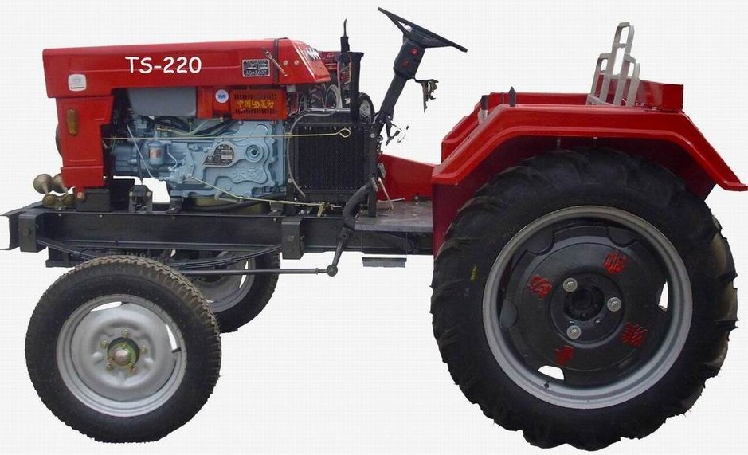
Find the Fuel Activity
Notes:
Trainer Note: Walk through training materials, steps, and recording of the Find the Fuel activity and answer questions from trainers as needed so that they can teach this activity in the future .

Slide 43
Jefferson/Baxter case example

Slide 44
Why one and not two case examples?
Request from CalSWEC regarding Core 3.0 for single case example
More time to focus practice strategies for completing tools with families
Built in a variety of complex issues that mirrors daily practice

Slide 45
Development of case example
Started with Harding/Layer case example
Consultation with both CalSWEC AND field staff
Development of case example by CRC
Multiple scorers: internal CRC and field workers

Slide 46
Features of new case example
Participants will need to think through households and caregivers carefully
Models how SDM tools are used with families
Replicates reality of how tools are used to replicate assessment processes with families
Multiple Safety Assessments over time
Realities of a two-household case

Slide 47
Hotline Segment teaching points
Most injuries are “other, “ reinforce criteria for severe injury by referring to definition
Case example makes it tempting for some to mark General Neglect: inadequate medical/mental health
Difference between duplicate, associated and historical
Evaluate Out/Referred Out – actions
Substance-exposed infant – 24 hour response
Three Questions structure of screener narrative
Provisional Harm Statement

Slide 48
Safety Assessment Segment 1 teaching points
Case example replicates the process that is used in the field to:
Assess households
Identify safety threats
Safety plan as needed and possible
Two different households, two different Safety Assessments
Intimate partner violence item not at threshold
Community oversight item a tempting choice
Mom’s Safety Assessment completed without contact with Mom

Slide 49
Safety Assessment Segment 2 teaching points
Case example replicates the process that is used in the field to:
Assess households
Identify safety threats
Safety plan as needed and possible
Two different households, two different Safety Decisions
Mom’s Safety Assessment completed without contact with Mom
Safety plan with Dad, not Mom
Sample safety plan

Slide 50
Risk Assessment Segment teaching points
Reinforce the updating of Dad’s Safety Assessment following protective placement
Two households, two risk assessments
History items different by household
WebSDM referrals: one in referral, one on paper (most severe in computer)
WebSDM cases: more than one household

Slide 51
FSNA Segment teaching points
Danger statements
Use of family meeting to interview for FSNA
Tom’s multiple needs
Identification of support network
Cultural context and the cultural item
Trauma versus mental health
CWS/CMS case plan objective map – trauma and SCP

Slide 52
Reunification Reassessment Segment teaching points
Training flow does not match flow of Policy and Procedure Manual as in previous Basic Orientation, but it does match typical case.
Note goal statements and behavioral case plan objectives – opportunity for a learning discussion
New format of Reunification Safety Assessment
Remind workers to use original Safety Assessment definitions to consider any new Safety Threat in home
Opportunity to use structure for status review Assessment and Evaluation argument

Slide 53
Risk Reassessment Segment teaching points
Prior history items are mom’s, not dad’s
Reinforce opportunity for after-care planning
Reminder on Safety Assessment
Opportunity for discussion regarding introduction of Carol into Tom’s life.

Slide 54
Notes:
Ask: Does anyone have final questions on the material covered?

Slide 55
(+) Plus | (Δ) Delta
What worked? | What could be done differently next time?

